Slide 1


Bereavement Support Manager​
September 2026​
Application Information​

Slide 2
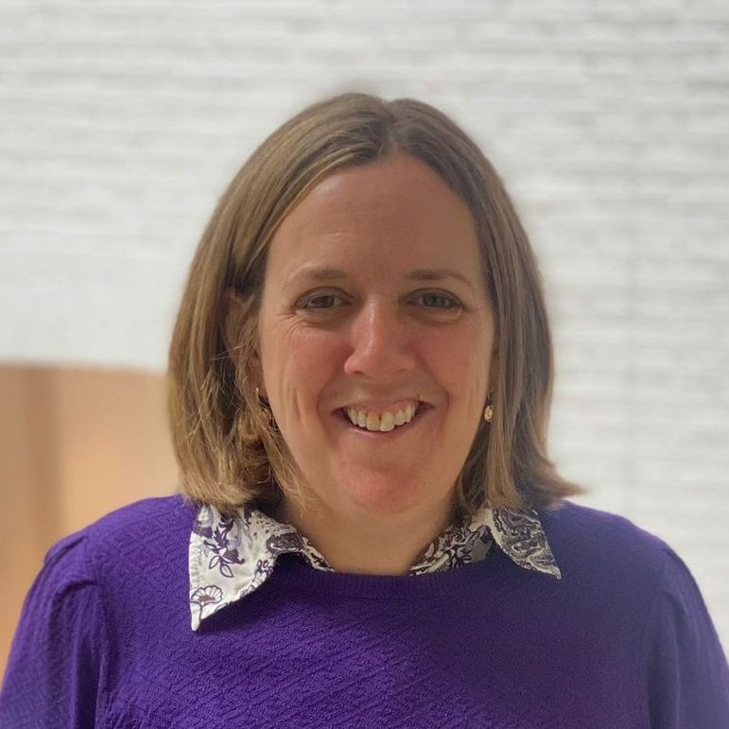
Welcome
Hello prospective candidate! We are really pleased that you are interested in working with us here at The Lullaby Trust. Let us tell you more about our organisation.​
It is a key time to be joining the charity and helping us to continue to save babies’ lives and support bereaved families. The charity has been hugely successful, but the work is far from done. The impact of the sudden death of a baby is wide and never goes away, as we know from the families that we support. This drives all our work, across each department. We are a close and friendly staff team who all share passionately in the charity’s objectives, vision and values.​
​
In March 2026, The Lullaby Trust took on the work of the Scottish Cot Death Trust (SCDT), ensuring its vital support and expertise could continue in Scotland following financial challenges faced by SCDT. This is a new role within the bereavement support team as we expand our working into Scotland. This role is to provide high-quality emotional support and advocacy to bereaved families, while leading the development and delivery of bereavement support services.
If you are enthusiastic and have the skills and experience we are looking for, we encourage you to apply.​
Jenny Ward​
Chief Executive

Slide 3

About us
The Lullaby Trust is a charity that saves babies’ lives and supports bereaved families. Around 3 babies a week still die from sudden infant death syndrome (SIDS) and we are committed to bringing that number down to zero.​
Through educating parents on how they can reduce the risk of SIDS and investing over £12million in research, we have played a key role in reducing the number of babies who die from SIDS by 80%, saving the lives of more than 30,000 babies.​
Each year we train thousands of health professionals to support parents in sleeping their baby safely. We campaign tirelessly to raise awareness of SIDS and ensure our life saving advice reaches all parents.​
The Lullaby Trust supports bereaved families, through our helpline and befriending scheme. Our work with the NHS to provide a Care of Next Infant Programme (CONI) offers a lifeline to bereaved families expecting a new baby.​
At The Lullaby Trust, we provide an incredibly supportive working environment that embraces hybrid working, flexible hours, and individually tailored schedules. This empowers you to plan your work life according to your personal preferences and commitments, ensuring a fulfilling and balanced professional experience. If this interests you, we would love to hear from you!​

Slide 4

Our values
Caring​
We care about all the people we support and always show compassion, warmth and understanding.​
​
Reassuring​
We are supportive, clear, informative and
non-judgemental.​
​
Trustworthy​
We have expert knowledge based on scientific evidence, data and experience.​
​
Driven​
We won’t stop until no baby dies suddenly
and unexpectedly.​

Slide 5
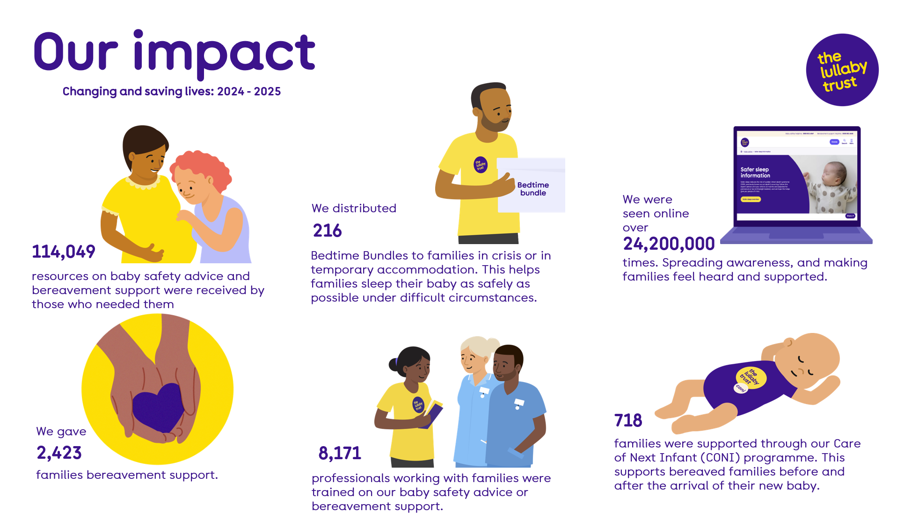

Slide 6
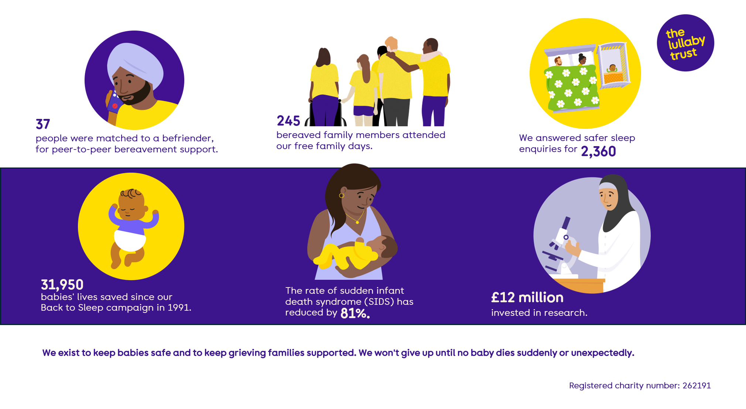

Slide 7

The role
Main function of job​
The purpose of this role is to provide high-quality emotional support and advocacy to bereaved families across Scotland, while leading the development and delivery of bereavement support services.
The Bereavement Support Manager will play a key role in expanding services, including the befriending programme, and ensuring consistent, compassionate support for families following the sudden and unexpected death of a baby or young child.
​
Provide and lead high-quality bereavement support to families, ensuring timely and compassionate responses to all enquiries.
Ensure the bereavement support services are promoted to those bereaved and to professionals working with bereaved families in Scotland
Ensure all service records and databases are accurate, up to date, and maintained in line with organisational guidelines.​
Post​:
Bereavement Support Manager (Scotland)
Location​:
Hybrid between home and Glasgow office, with some travel across Scotland.
Minimum once a week in the office
Department:
Support and information​
Salary:
£40,000 FTE ​
Hours​:
35 hours a week
Responsible to​:
Head of Support and Information​
​

Slide 8
Main duties and responsibilities
Provide and lead high-quality bereavement support to families, ensuring timely and compassionate responses to all enquiries.
Oversee, develop and expand bereavement support services in Scotland in line with the charity’s strategic goal to support all bereaved families whose baby or young child dies suddenly and unexpectedly.
Be the primary contact for and manage the bereavement support services in Scotland.
Develop and manage, in partnership with the Head of Support and Information, the Befriender programme in Scotland.
Work with the Head of Care of Next Infant (CONI) to ensure support is available for any bereaved family in Scotland with subsequent pregnancies.
Provide emotional and practical support to families after a baby or young child’s sudden death, maintain ongoing contact and long-term support.
Advocate for families to help them navigate the Child Death Review process; liaising with the various multi agency professionals involved including Crown Office and Procurator Fiscal Service, paediatricians and other professionals working in the child death review process.
Act as a ‘Keyworker’ for families within the Child Death Review process where one is not already assigned.
Cover and answer the bereavement support helpline and online enquiries responding within the set guidelines and KPIs for the department.
Ensure any safeguarding concerns are actioned in accordance with the organisations Safeguarding policy.
Send materials to bereaved contacts, including bereavement packs and follow up e-cards.

Slide 9
Main duties and responsibilities continued
Organise and facilitate face to face events for bereaved families including family days and memorial events to an agreed programme.
Collaborate with the Engagement Team to develop and deliver bereavement support content for social media.
Ensure the bereavement support services are promoted to bereaved families and professionals working with bereaved families in Scotland
Join and participate in stakeholder and baby loss collaboration meetings and events.
Represent and present the Lullaby Trust’s work externally including speaking at events to raise awareness of the service and organisation.
Raise the profile of the service and organisation throughout Scotland, including networking face to face.
Keep up to date with the bereavement support world including joining National Bereavement Alliance, Child Bereavement Network and research around grief and bereavement.
Ensure all service records and databases are accurate, up to date, and maintained in line with organisational guidelines.
Ensure all paperwork and databases are updated with each contact in line with the department guidelines, including Raiser’s Edge, Excel databases.
Maintain ongoing knowledge and training on the Lullaby Trust’s advice and the scientific knowledge behind this advice.
Collate statistics, as required on areas of work within the support services team.
Assist with the services’ evaluation and impact processes including self-evaluation feedback.
Provide other administrative support to the team as required.
Other:
Attend and participate with External Supervision sessions.
​

Slide 10
Person specification
Qualifications/education required:​
At least 3 years experience of supporting bereaved families ​
Competencies required:​
Essential
Direct experience of supporting bereaved families
Direct experience managing support service ideally bereavement support
Demonstrate an understanding of, and empathy with the issues surrounding the death of a baby. ​
Experience of working on a helpline ​
Experience of supervising and supporting volunteers
Understanding of Child Death Review & connections in this field
Demonstrate a warm, clear, and considered telephone manner ​
Excellent active listening skills ​
Evidence of professionalism and boundaries ​
Confident presentation, facilitation and influencing skills.
Excellent verbal and written communication skills and ability to use these appropriately to offer telephone and online/ email support to bereaved individuals and others contacting the service
A thorough understanding of confidentiality and safeguarding.​
Desirable
Experience of working on digital support e.g. WhatsApp and webchat
Experience / understanding of trauma-informed practice
Experience of using a CRM system, particularly Raisers Edge
Personal characteristics required:​
Ability to maintain confidentiality.​
Ability to work autonomously and make decisions
Able to work collaboratively as member of a team​
Able to manage and communicate status of workload
Demonstrate empathy and compassion for others and hold a non-judgmental attitude
Willingness to adapt to changing priorities​
Self-disciplined to work remotely at home​
Commitment to the organisation’s strategic goals
Willing to keep skills up to date and attend training as necessary. ​
Willingness to work flexibly with very occasional evening and weekend work supporting charity events and conferences.
Specialist training required:​
Training will be provided on safer sleep advice.​

Slide 11
Organisational structure
Chief Executive
Head of Finance
Finance Officer
Income Officer
Head of Support and Information
Policy and Research Manager
Support Services Coordinator
Public Health Engagement Manager
Support and Training Officer
Bereavement Support Adviser x2
National Lead for CONI Programme
National CONI Coordinator
Head of Income and Engagement
Supporter Engagement Manager
Engagement Team Assistant
Community and Challenge Events Officer x2
Supporter Engagement Officer
Corporate Partnerships Manager
Senior Trusts Officer
Digital Marketing Manager
Graphic Designer
Digital Marketing Officer
Senor Database Officer
People and Operations Manager
Training
Development Officer
Fundraising Officer
Digital Bereavement Support Advisor

Slide 12
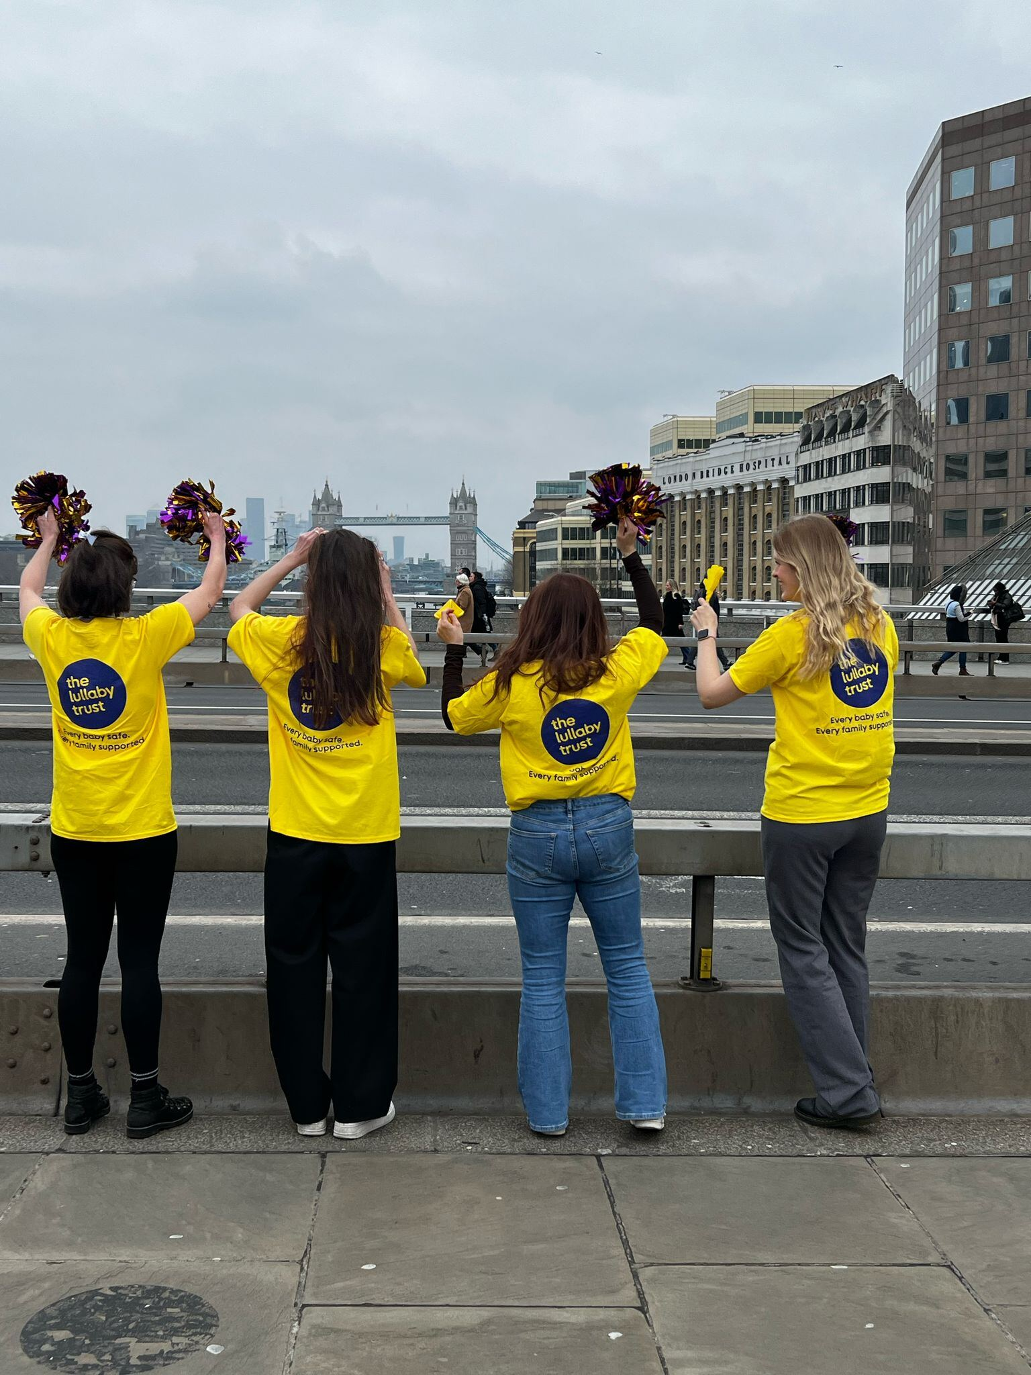
Key benefits
25 days annual leave plus 8 days paid public holidays every year (pro rata for part time staff)​
Additional leave between Christmas and New Year when the office closes​
Flexible and remote working is available to all staff​
Enhanced company Maternity and Parental Leave​
Any member of Staff affected by loss of a close family member will be granted compassionate leave paid at their normal salary​
Ability to buy up to 5 extra days of holiday​
A company pension scheme with matched contributions of up to 5% after 3 months​
A healthcare cash plan free of charge to all staff, enabling staff to claim 100% of the costs of everyday healthcare up to annual limits​
24/7 Employee Assistance Programme offers free, confidential and impartial support, information, and counselling service to staff on legal, financial, debt management and emotional issues​
Long service leave entitlement after 3 years of service​
Up to 1-year unpaid sabbatical leave after 5 years of service​
Free travel loan to work after successful probation​
Free eye-care vouchers after successful probation​
Free will writing service​

Slide 13
Removing bias during the recruitment process​
In line with our commitment and desire to build a diverse workplace we have put some processes in place to ensure a fair recruitment process.​
The Application​
If written format is not your preferred method of communication, we also offer the opportunity to apply via video recording instead. Simply send us a video recording of yourself answering the key questions on the application form via Whatsapp to 07310265249 and our recruitment team will type them up to maintain your anonymity.​
The recruitment process is blind. When you apply, your personal details are anonymised to avoid any unconscious bias and we use a standardized scoring system to ensure fair shortlisting of candidates for interview.​
Ask our recruitment team any questions or voice any concerns and the team will happily support you in overcoming any barriers that we may have missed.​
The Interview​
We will be as flexible as we can to ensure you can attend your interview. We send out any interview tasks you will be asked prior to your interview to give you time to prepare meaningful answers.​
We have a member of the team who is trained in Safer Recruitment on the panel for each interview to ensure a fair and safe process.​
We use a standardised scoring sheet for each interview with pre-agreed criteria based on the Candidate Pack and and any tasks. At the end of the interview, each panel member gives their overall score and we take an average of these to reduce any risk of bias.​

Slide 14

To apply
Please visit the job advertisement on charity jobs to apply . Applications will close on Monday 19th October at 5:00pm.​
Early applications are encouraged as we will review applications throughout the advertising period, and reserve the right to close the advert early should we receive a sufficient number of applications.​
Interviews may be held during the advertising period or shortly after the close date.​
Please note interviews will be held over Microsoft Teams.​
​
If you have any questions, or would like to discuss your application, please email the People and Operations Manager on office@lullabytrust.org.uk​
Registered Charity Number: 262191​

